Slide 1
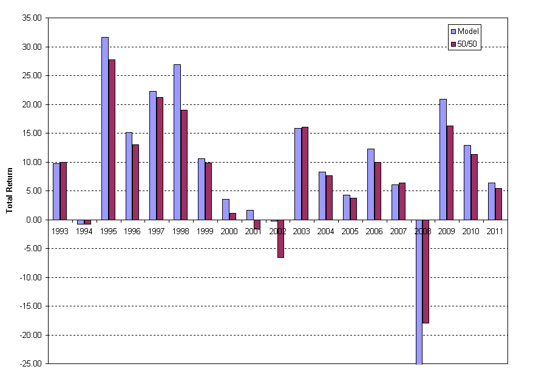
Bonds – Stocks Allocation Model: Simulation (Jan 93 – May11)
Annualized Return Advantage* = 140 bp
Bonds: Barclays U.S. Aggregate Bond Index; Stocks: S&P 500
Model: Option to rotate 20% of portfolio to stocks or bonds from neutral blend (50% / 50%) each month.
Likelihood of actionable signal: 60% (132 of 221 months); Model accuracy: 66%
* no transaction costs

